Slide 1
MULTIPLE BREAK REBAR
Advisor : Prof. K.C.Chang
Presenters : You-Ran Nai

Slide 2
Incremental dynamic analysis
Dimitrios Vamvatsikos and C. Allin Cornell
EARTHQUAKE ENGINEERING AND STRUCTURAL DYNAMICS
2002
Notes:
Department of Civil and Environmental Engineering; Stanford University; CA 94305-4020; U.S.A.

Slide 3
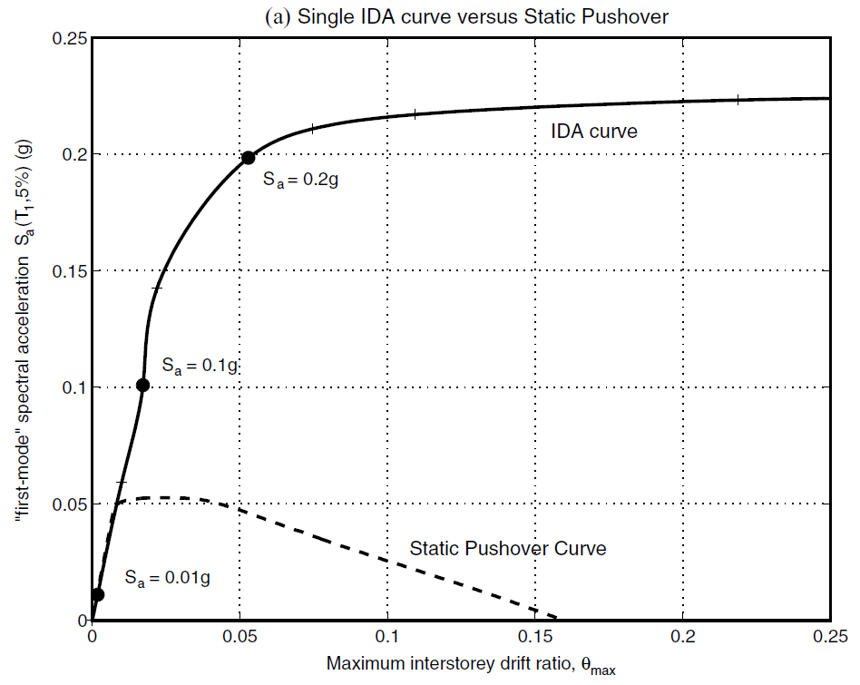
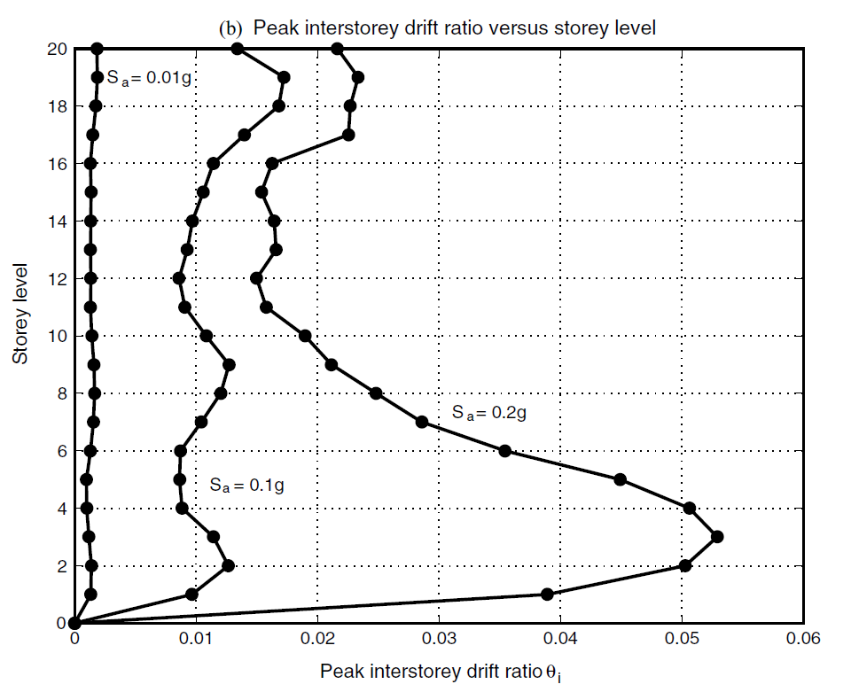
INTRODUCTION
SINGLE STATIC ANALYSIS
➔
INCREMENTAL SPO
SINGLE TIME-HISTORY ANALYSIS
➔
INCREMENTAL ONE

Slide 4
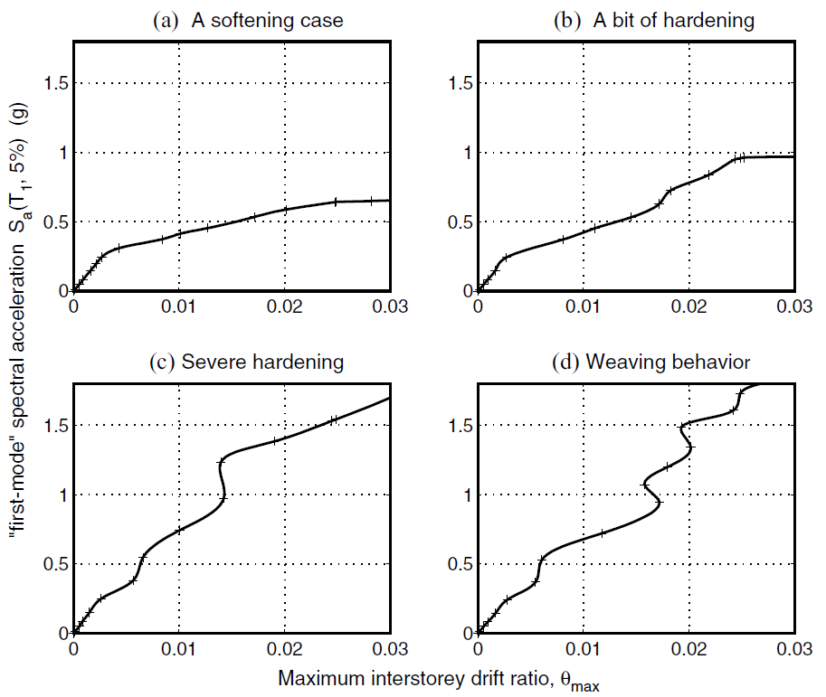
INFINITY
SOFTENS
0.2g
？
SOFTENING
&
HARDENING
EQUAL DISPLACEMENT
0.2g
Notes:
SOME GENERAL PROPERTIES

Slide 5
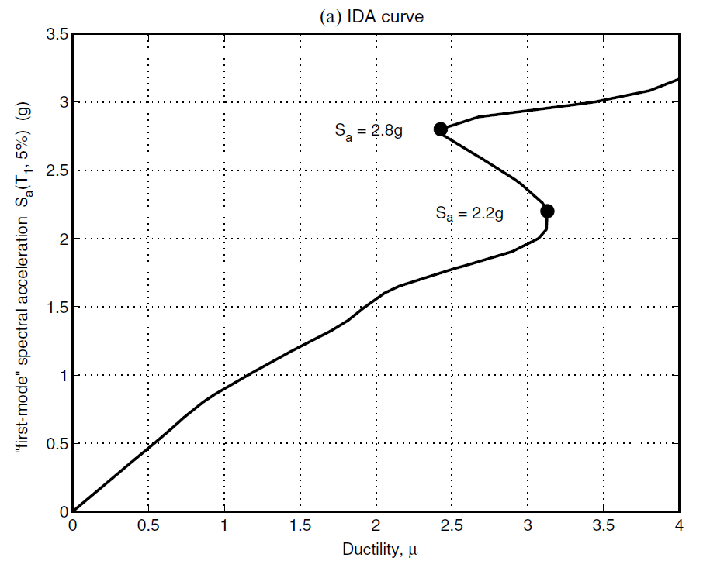
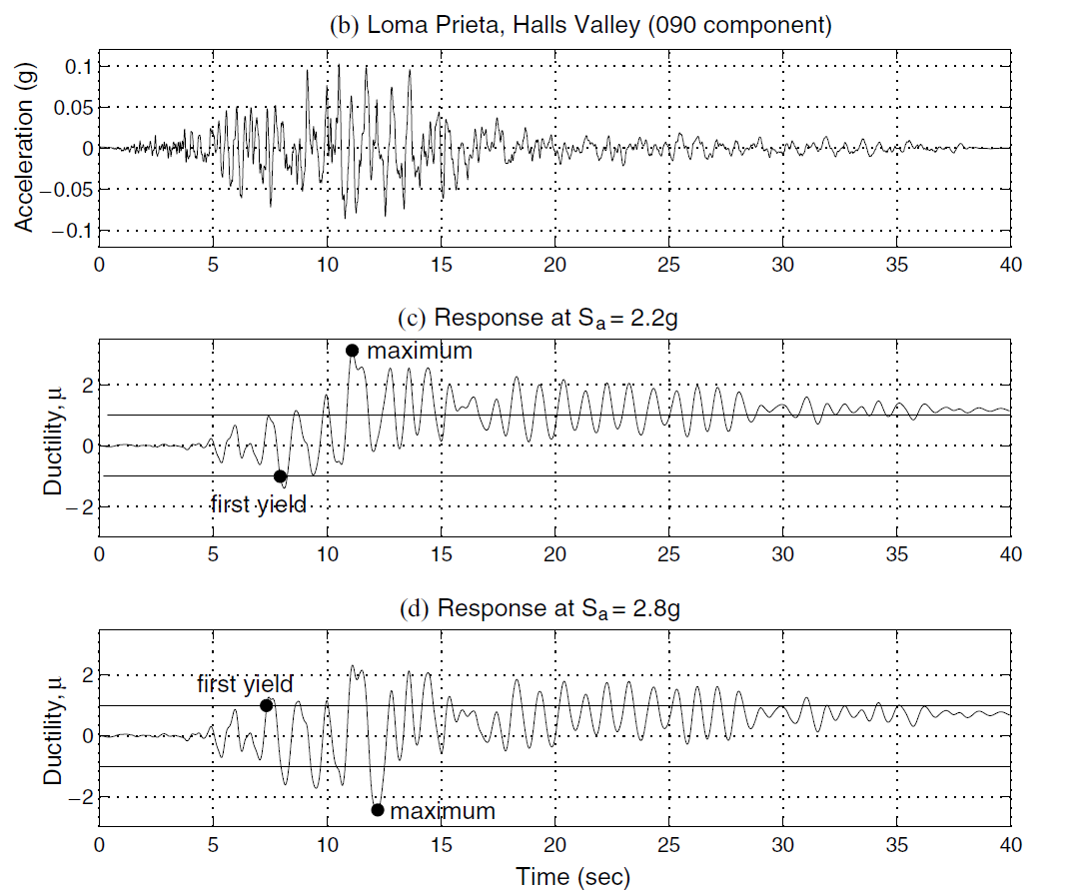
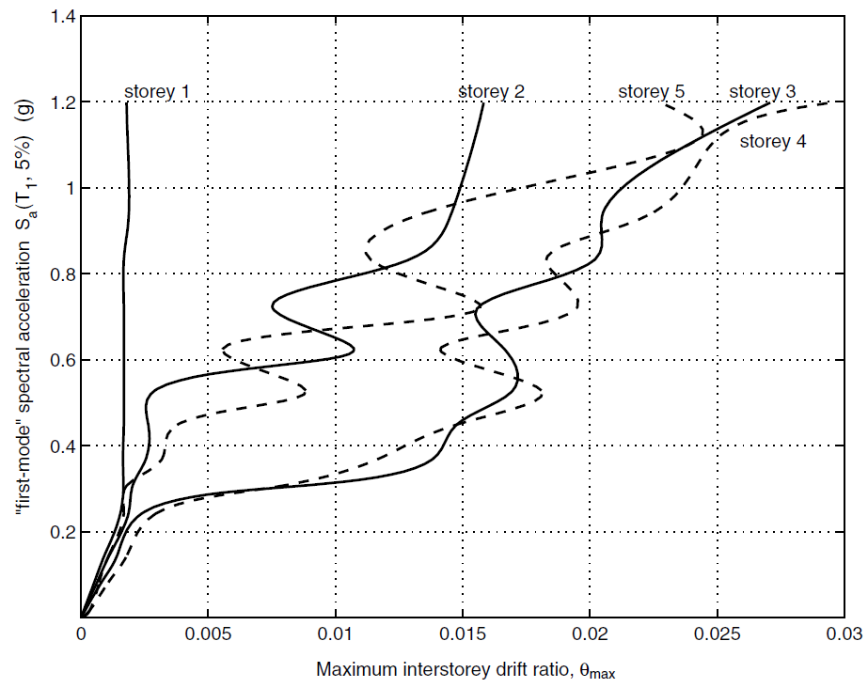
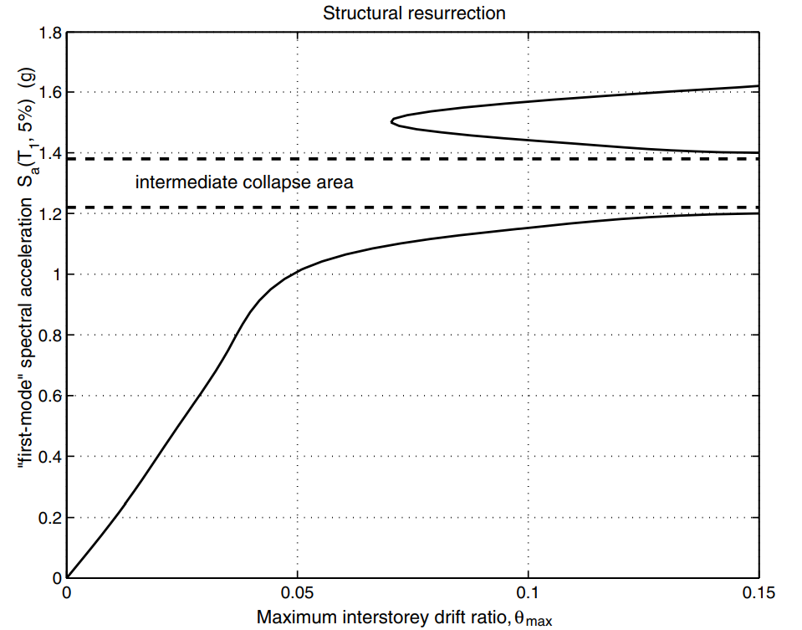
EARLIER YIELDING
FUSE
STRUCTURAL RESURRECTION

Slide 6
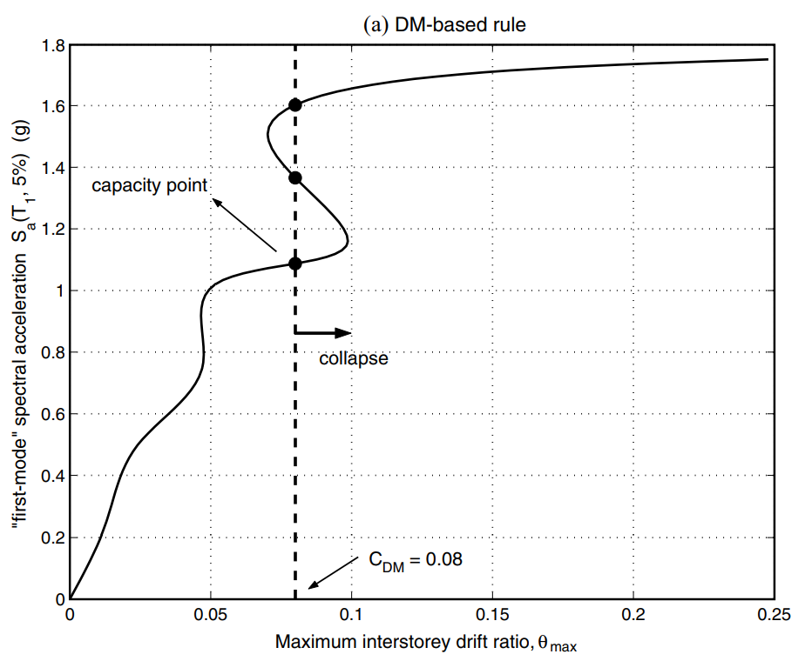
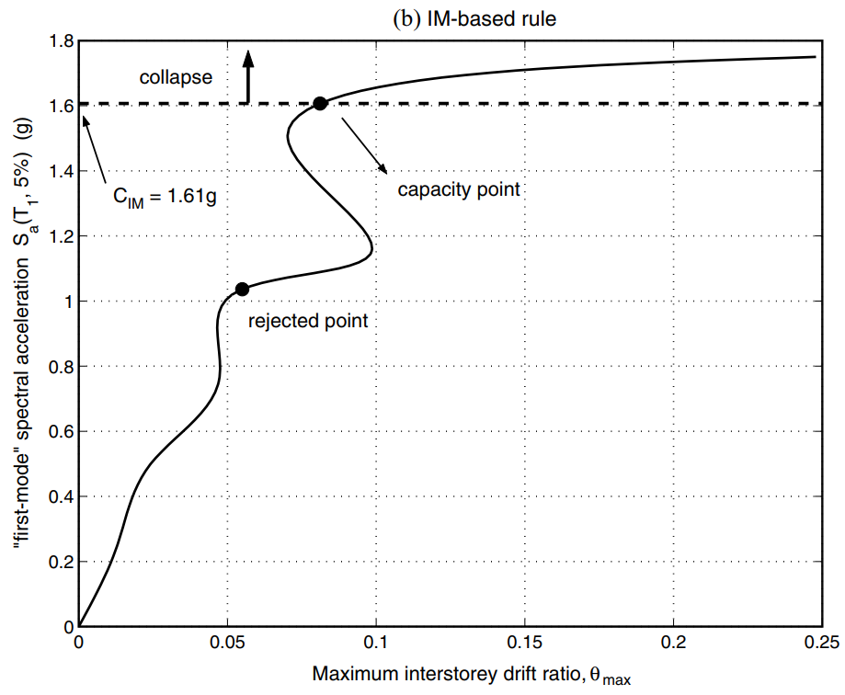
CAPACITY AND LIMIT-STATES
FEMA 20% TANGENT SLOPE APPROACH
Notes:
CAPACITY AND LIMIT-STATES

Slide 7
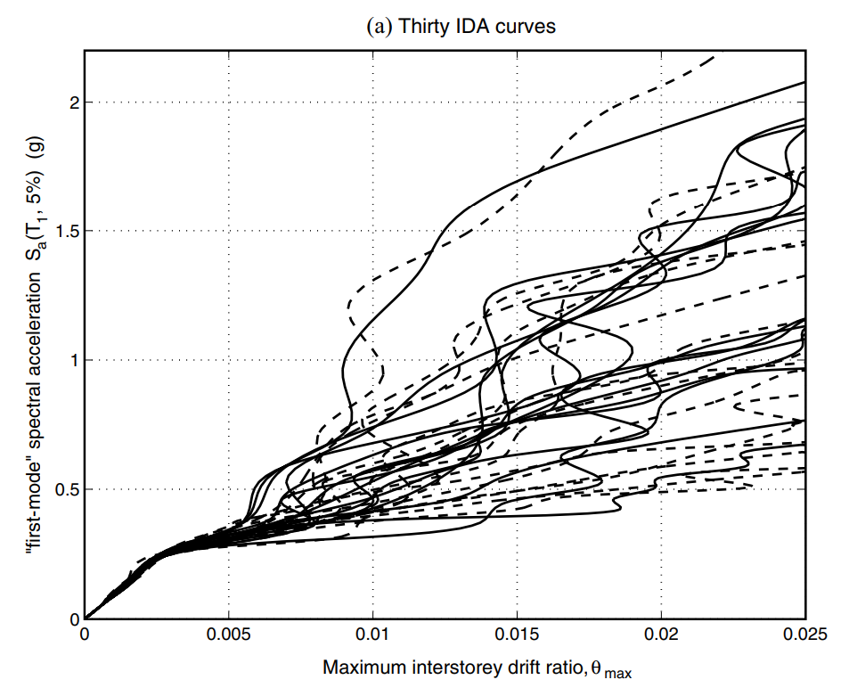


MULTI-RECORD
PARAMETRIC METHODS
NON-PARAMETRIC METHODS
MEAN
MEDIAN
CAPACITY

Slide 8




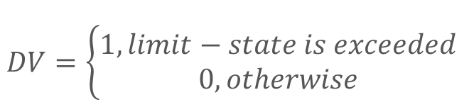

PBEE FRAMEWORK
$$DV=\left\{\begin{aligned}1, limit−state is exceeded \\ 0, otherwise\end{aligned}\right.$$
$$λ\left(IM\right): hazard curve$$
$$G\left(DM | IM\right):(conditional) complementary cumulative distribution$$

Slide 9
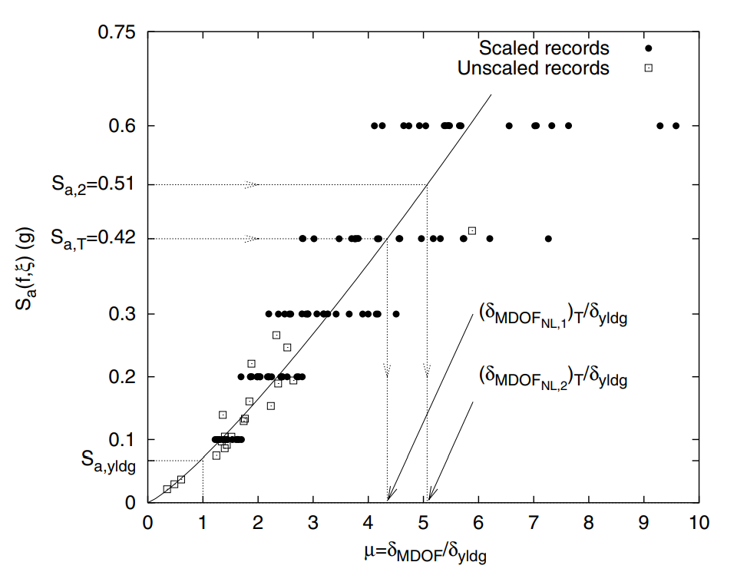
SCALING LEGITIMACY
ROOF DUCTILITY RESPONSE OF A
T₁= 1s
MDOF STEEL FRAME SUBJECTED TO
20 RECORDS
SCALED TO 5 LEVELS OF Sa(T₁,5%)

Slide 10
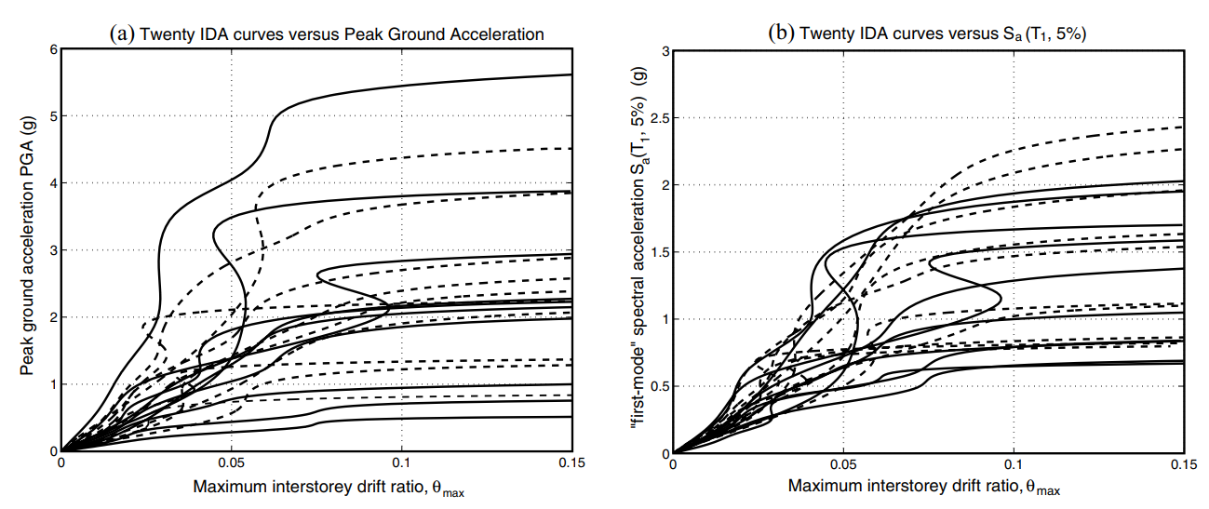
PGA
Sa(T₁,5%)

Slide 11
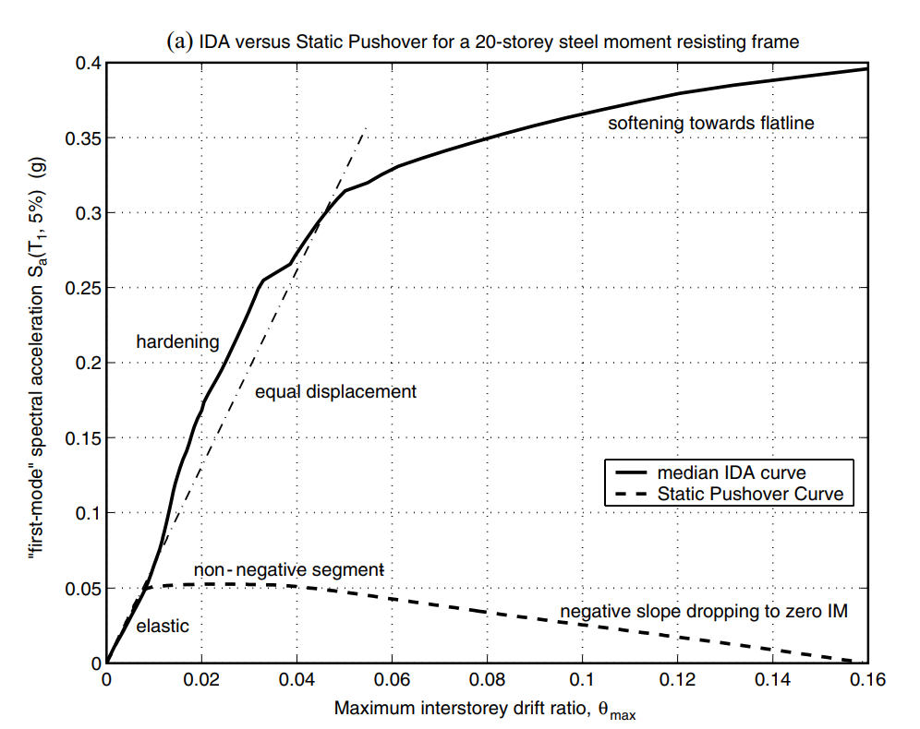
NON-LINEAR SPO
ELASTIC
➔
MATCH
NON-NEGATIVE
➔
EQUAL DISPLACEMENT
NEGATIVE
➔
SOFTENING

Slide 12
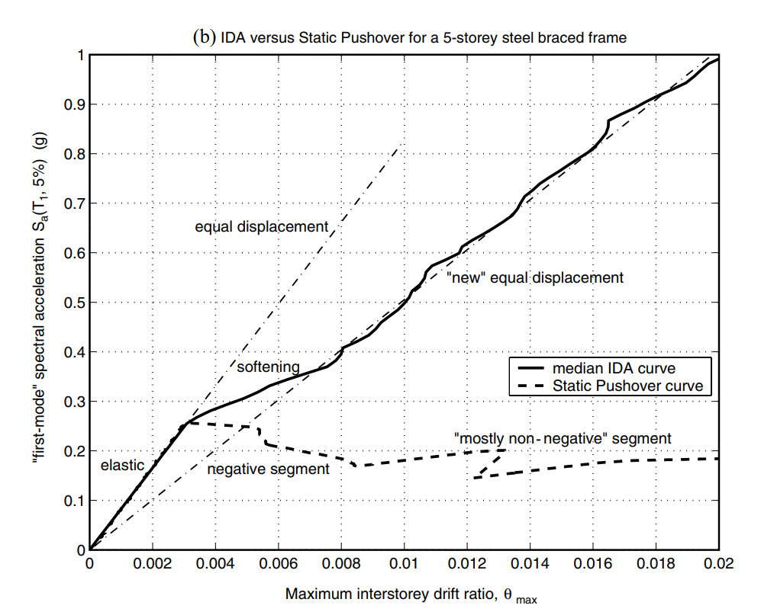
NON-LINEAR SPO
NEGATIVE => NON-NEGATIVE
NEW
EQUAL DISPLACEMENT
➔

Slide 13
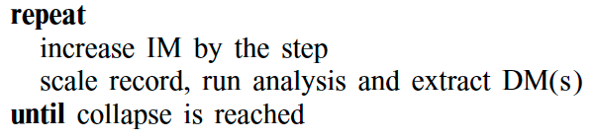
IDA ALGORITHMS

Slide 14
IDA ALGORITHMS
LESS POINTS
MORE POINTS

Slide 15
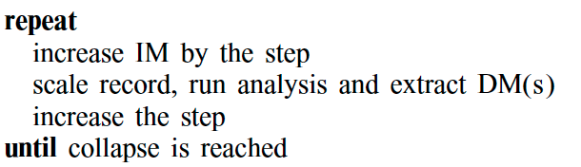
HUNT & FILL TRACING ALGORITHM
HUNTING PHASE

Slide 16
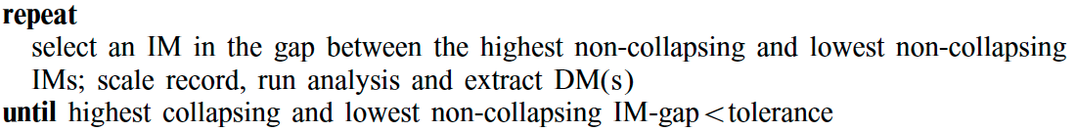
FILL PHASE –
CAPACITY RESOLUTION

Slide 17
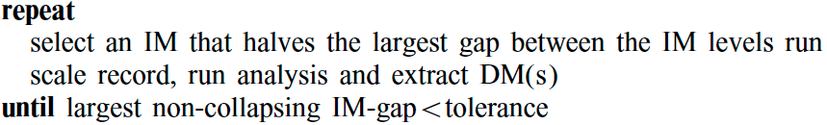
FILL PHASE –
DEMAND RESOLUTION

Slide 18
CONCLUSIONS
SINGLE IDA
MULTI-IDA
OTHERS
SOFTENS, SOFTENING & HARDENING, RESURRECTION, LIMIT-STATES
STATISTICS METHOD
PBEE FRAMEWORK
SCALING LEGITIMACY
NON-LINEAR SPO
IDA ALGORITHMS

